Slide 1
Opening a new coffee shop in Toronto
IBM Data science capstone
Presented by : ANIBA
Date : 06.06.2021

Slide 2
Table of content
Introduction …………………………………………………………….1
Data Acquisition ………………………………………………….….2
Methodology ……………………………………………………….…..3
Discussion ………………………………………………………………..5
Conclusion ……………………………………………………………….5

Slide 3

Introduction and business problem
Data science and geospatial data .
determin the best location for busnisees ownrs
Starting a cofee shop in toronto.

Slide 4

Data sources and Acquisition
Data sources :
foursquare API ,
Toronto census ,
Wikipedia ,
Data needed:
toronto map ,
geospatial location ,
Toronto revenue.

Slide 5
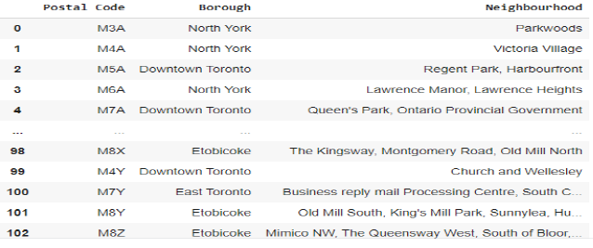
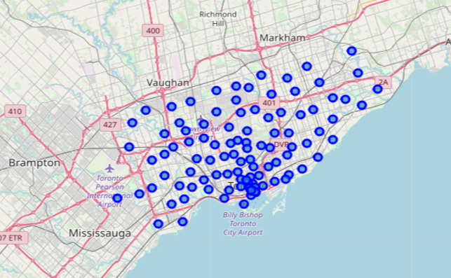
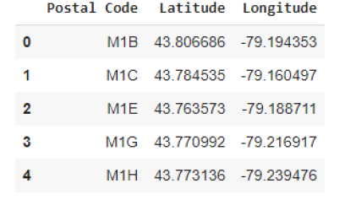
Methodology
Data need some cleaning , merging and visualisation

Slide 6
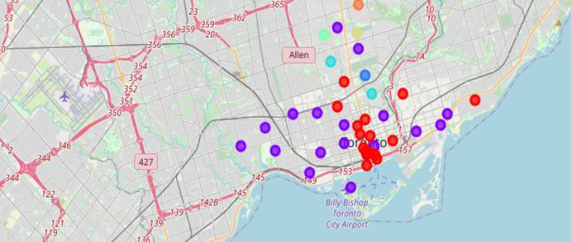
Clustering the neighborhood
Five clusters with diffrent caractrestics ( populations , revenus , power spending..)

Slide 7
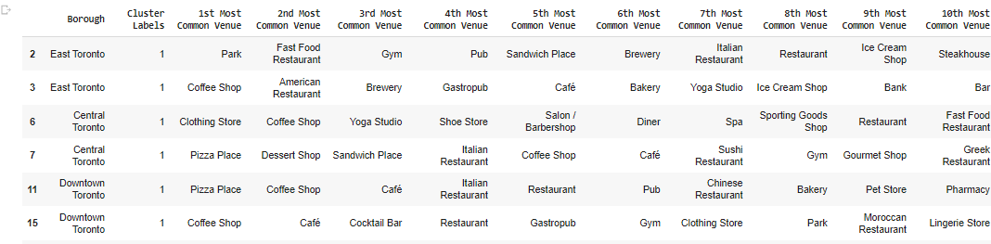
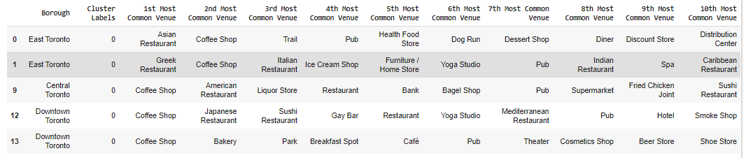
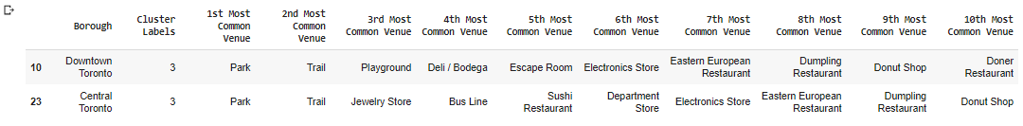
The Most revenues from each clusters

Slide 8
Discussion
The best place to open a restaurent is in cluster 1 showed in red below.

Slide 9

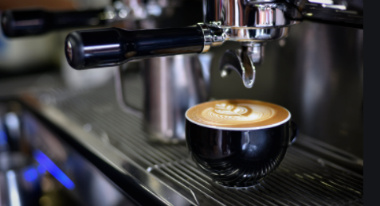
Conclusion
Data science can help You grow your busniess,
or start a new one.

Slide 10


